Slide 1
Practical – 6 DevOps – Part 2
Aruna Kumbhar

Slide 2
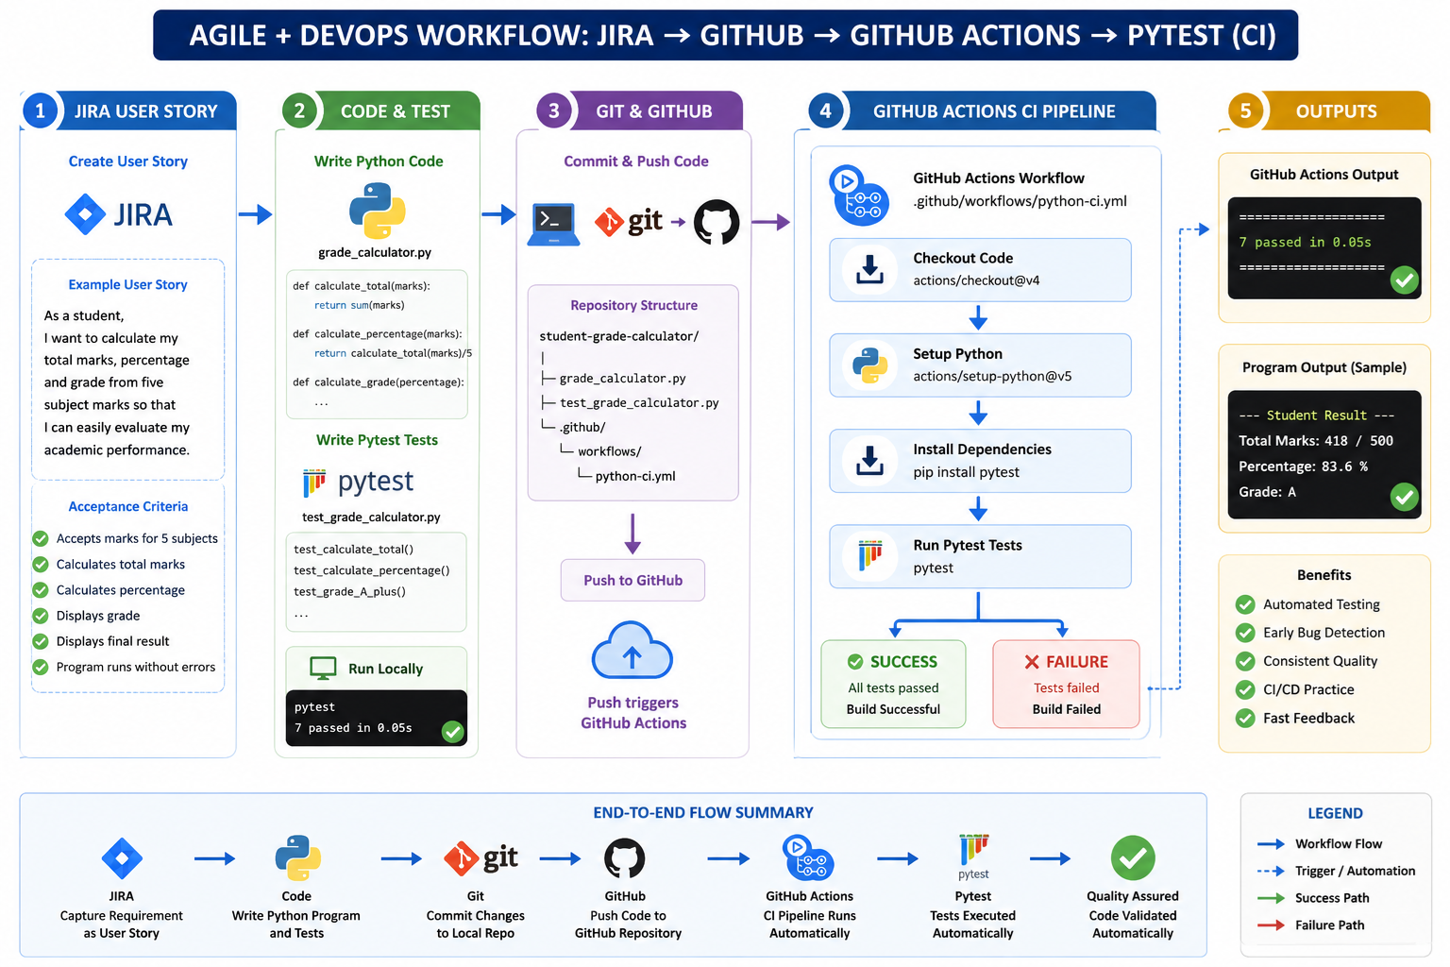

Slide 3
🎯 Objective
Develop a simple Python application that calculates a student's total marks, percentage, and grade based on marks obtained in 5 subjects.
Implement the requirement using an Agile/DevOps workflow:
Jira User Story → Python Code → GitHub → GitHub Actions CI Pipeline → Automated Execution
📌 Problem Statement
As a student, I want an application that accepts my marks in five subjects and calculates my total marks, percentage, and grade, so that I can quickly understand my academic performance.
Expected Output:
Total Marks: 418/500
Percentage: 83.6%
Grade: A

Slide 4
Step 1 – Create Jira User Story, subtasks and estimate the same
Summary:
Develop Student Grade Calculator
Description:
As a student, I want to calculate my total marks, percentage and grade from five subject marks so that I can easily evaluate my academic performance.
Acceptance Criteria:
Program accepts marks for 5 subjects.
Program calculates total marks.
Program calculates percentage.
Program displays the appropriate grade.
Program displays the final result clearly.
Python program executes without errors.

Slide 5
Step 2 – Create GitHub Repository
Repository name:
student-grade-calculator
Folder/Files structure:
student-grade-calculator/
│
|── grade_calculator.py
└── .github/
└── workflows/
└── python-ci.yml
Step 3 – Write Python Program
Step 4 – Push Code to GitHub
Step 5 – Create GitHub Actions CI Pipeline

Slide 6
Step 6 - Create the pytest file to test student grade calculation
Step 7 - Add pytest to GitHub Actions

Slide 7
name: Python CI
on:
push:
branches:
- main
jobs:
calculate:
runs-on: ubuntu-latest
steps:
- name: Checkout Code
uses: actions/checkout@v4
- name: Setup Python
uses: actions/setup-python@v5
with:
python-version: '3.12'
- name: Install Pytest
run: pip install pytest
- name: Run Python Program
run: |
echo -e "85\n78\n92\n88\n75" | python grade_calculator.py
- name: Run Tests
run: pytest

